Slide 1
FOREIGN PRISONERS
STANDARDS AND reality
Mrinal Sharma
Commonwealth Human Rights Initiative

Slide 2

Who Are We
FOUNDED IN 1987
ACCESS TO JUSTICE
Prison Reform
INDEPENDENT
Police Reform
NON-PARTISAN
ACCESS TO INFORMATION
NON-GOVERNMENTAL
STRATEGIC INITIATIVE PROGRAMME
Ensure the practical realization of human rights in the countries of the Commonwealth

Slide 3
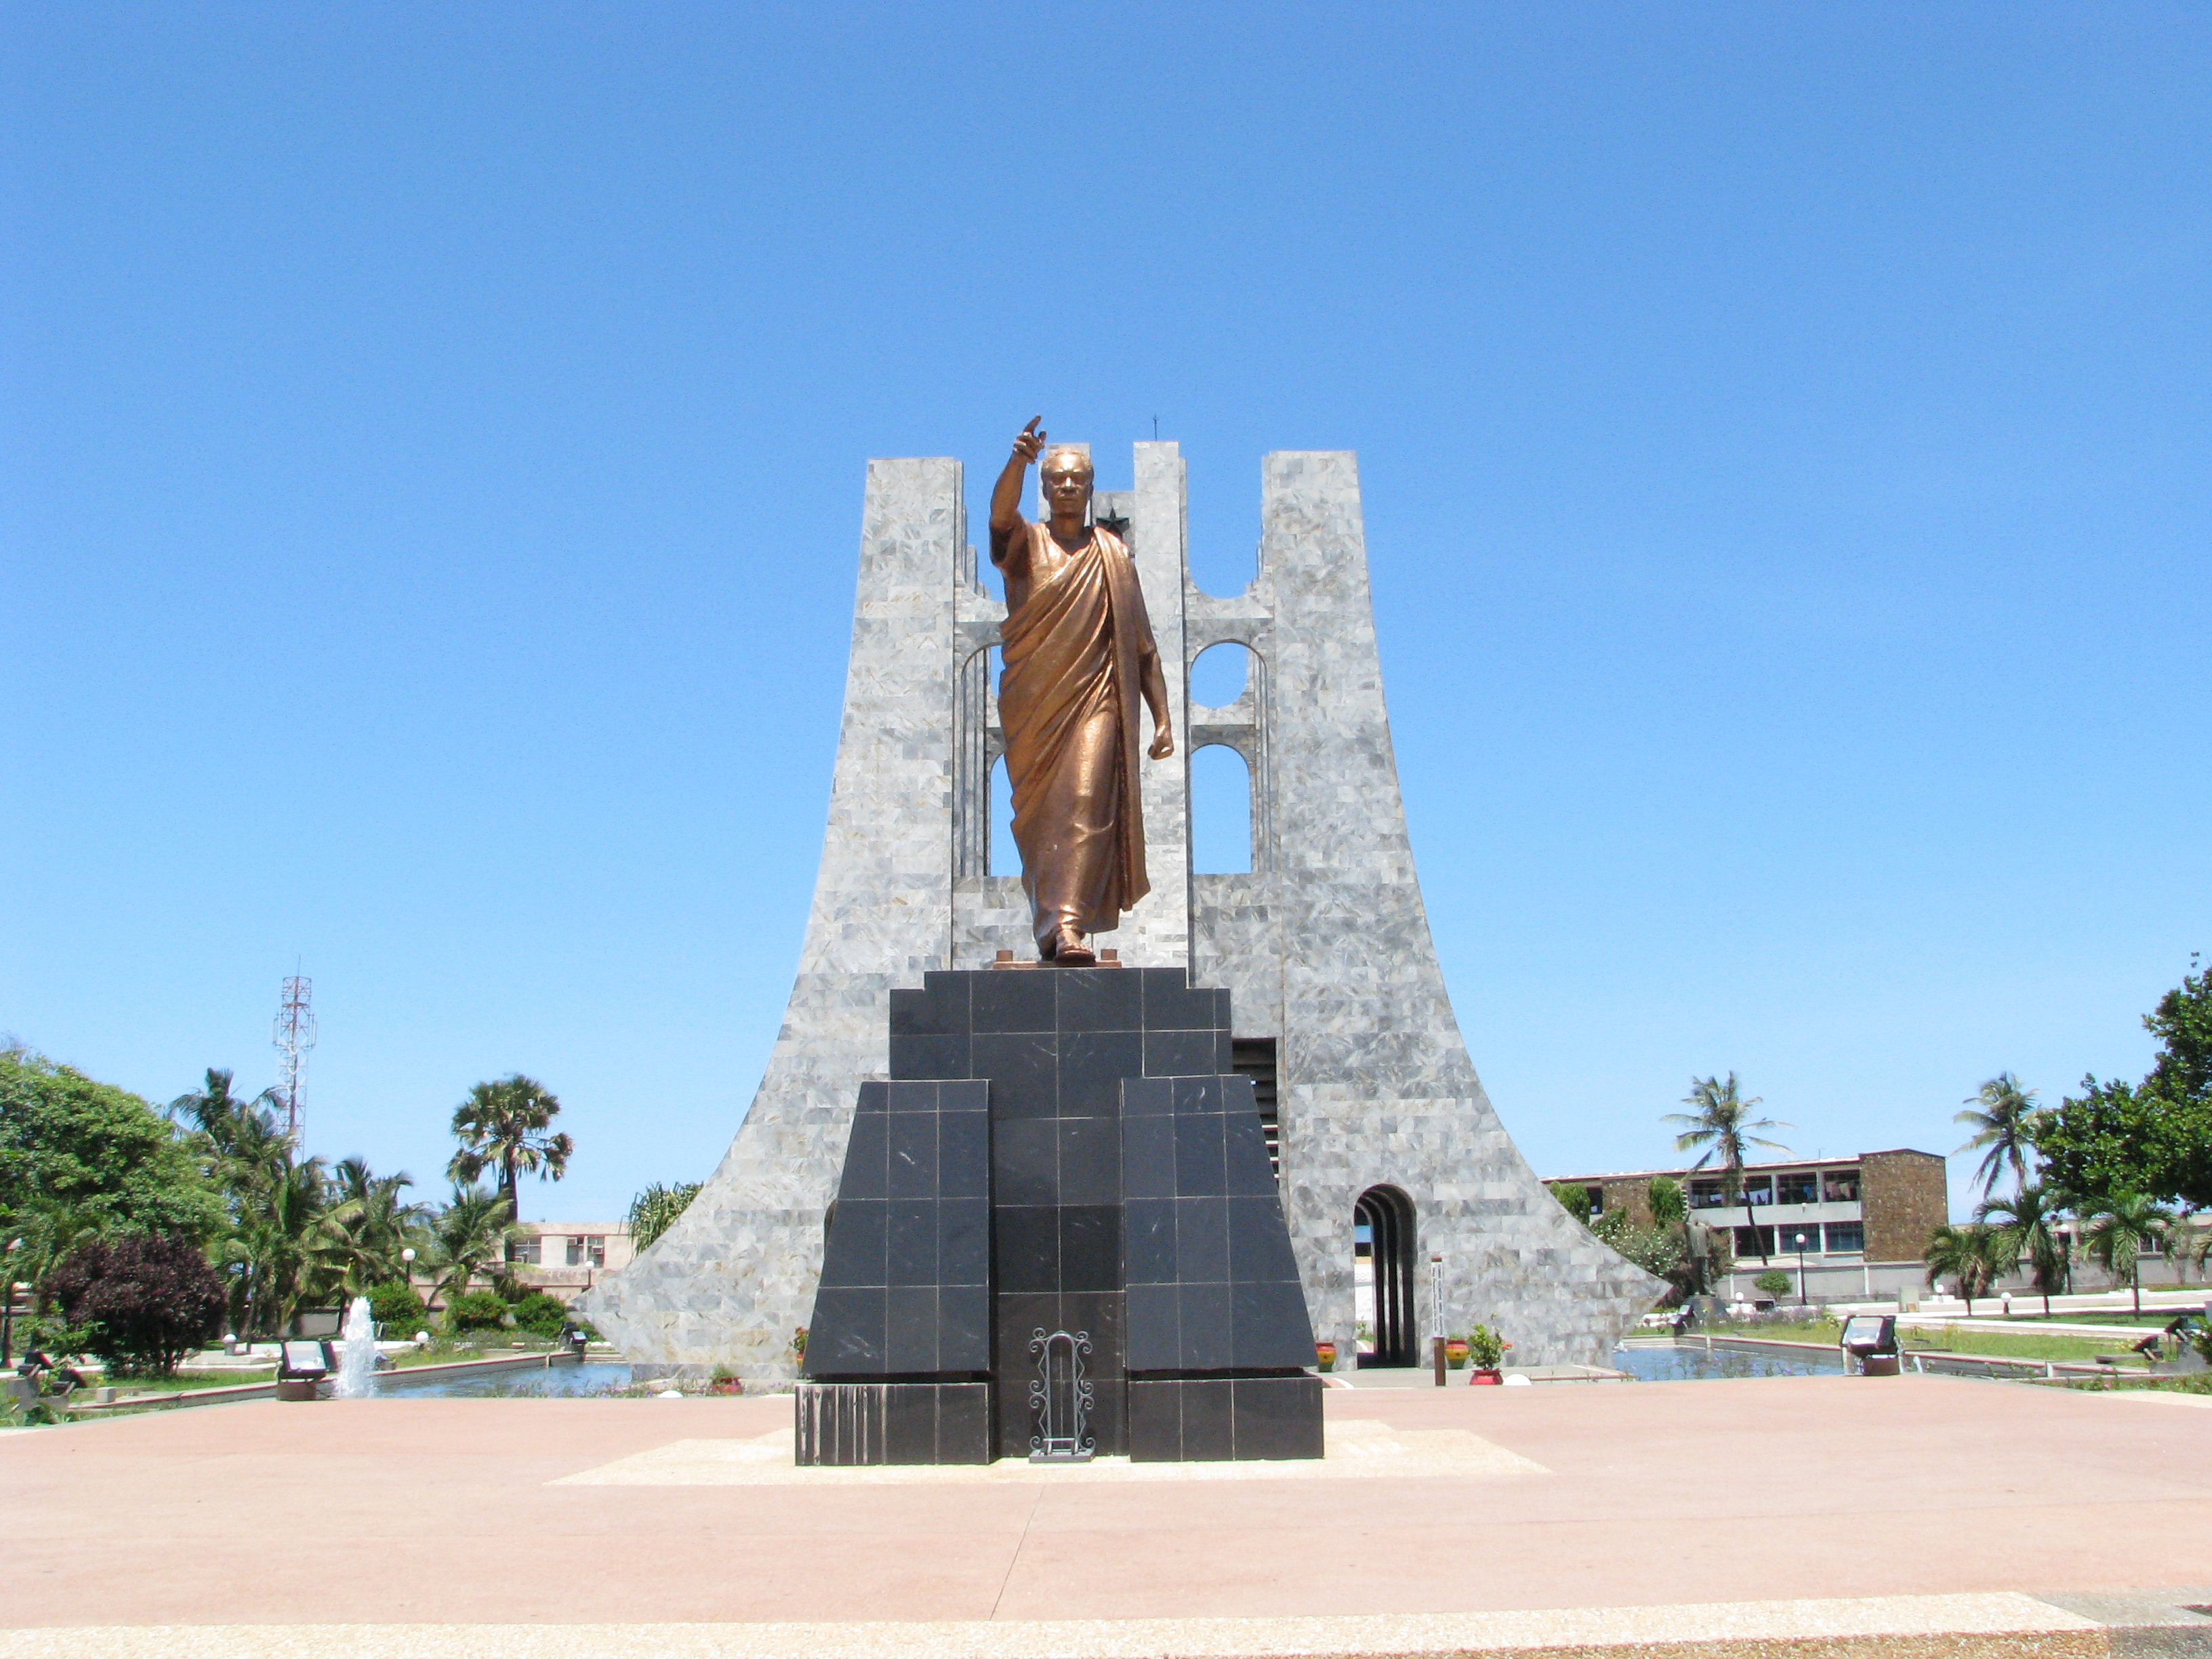
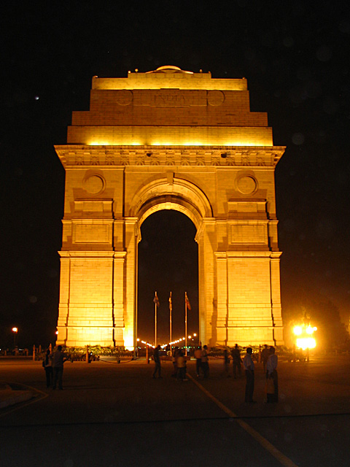
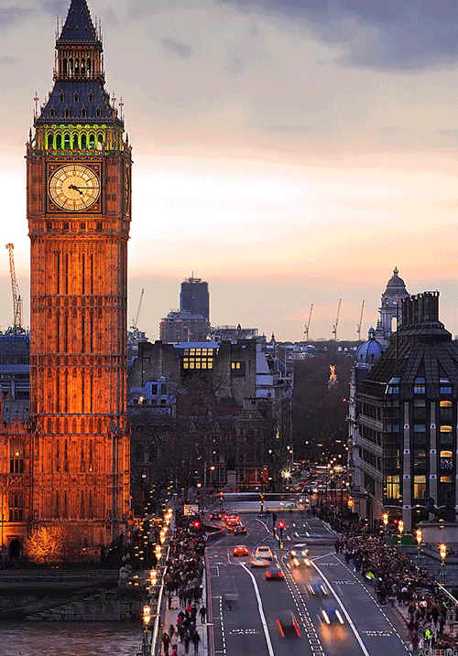
Where Are We
Accra, Ghana
New Delhi, India
London, England

Slide 4

Improve Monitoring of Prisons
Preventing Unnecessary Detention
Prison Reform

Slide 5




We prioritize the functioning of monitoring mechanisms inside prisons
We facilitate legal aid to prisoners
We work with Governments for early repatriation of foreign national prisoners
We build capacity of criminal justice functionaries related to prisons

Slide 6
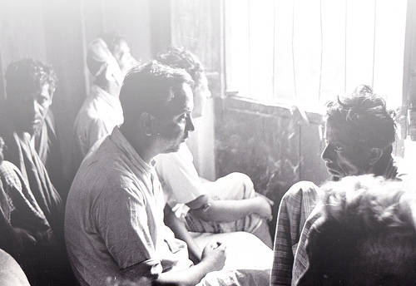
Types Of Cases
Early Repatriation
Enhance Coordination between actors
Restore Family Ties
Ensure Legal Representation
Insist on Non Custodial Measures
Advocate for Standard Operating Procedures
Overstay Prisoners
Asylum Seekers
Delayed Trials
Mentally Ill Persons
Juveniles
Victims of Torture

Slide 7

Difficulties faced by a Foreign Prisoner
ACCESS TO JUSTICE
Foreign Prisoners are at a higher risk of getting detained due to legislations like Section 14 of the Foreigners Act that mandates detention for illegal entry into the country. They are prone to torture due to their different ethnicity and special vulnerability. Foreign Prisoners are also at a disadvantage due to lack of understanding of the court and trial process of another country because of which they are usually misled by the lawyers into admitting the wrong crime.
LANGUAGE BARRIER
Absence of good interpreters renders the prosecution and trial of a foreign prisoner hazardous. It furthers their isolation in an unknown country. Linguistic difference also leads to their exclusion from different vocational and educational program.
IMMIGRATION STATUS
Foreign Prisoners are left with only two choices: Imprisonment and Deportation. Sometimes the home country does not want to take the prisoner back which leads to his prolonged detention.
DISCRMINATION
Foreign Prisoners miss out on certain statutory freedoms entitled to all the prisoners like parole, temporary release, open prison, remission, educational and recreational program. Lack of shelters and probation services lead to foreign prisoners relinquishing their right to parole, temporary release and transfer to open prisons.
CULTURE AND RELIGION
The religious, dietary, spiritual needs of a foreign prisoner end up not getting addressed by the Prison authorities. Psychological support is inadequate due to lack of understanding about other cultures.

Slide 8
Case Vignette
Khan Zaman
A 60 year old man finished his 10 years long sentence but had to wait for over 3 more years so that he could serve the punishment in lieu of non-payment of fine. Even after that he had to wait for 3 more months.
His 2 daughters and one son in the meantime were scattered and were forced to struggle in Afghanistan as rag pickers.
He paid what he owed to the State, even then…
JOHRA
A Rohingya Muslim from Myanmar was arrested by Border Security Force and thrown behind bars in India while she fled persecution.
Her children were separated from her.
She was sentenced for 1 year but it took 5 years for her to find the elusive freedom.
ARIFUL
A 5 year old boy detained in Bangladesh prison with his grandparents, who were sentenced to 2 months of imprisonment.
It took 10 more months for the authorities to coordinate and verify their nationalities.
Ariful remained behind bars for 1 year.
Gholam
A 14 year old boy trafficked to India from Bangladesh.
Apprehended and sent to Observation Home in West Bengal.
When he was sent back to Bangladesh after a delay of 4 years, his widowed mother broke down thinking he had died.

Slide 9
International Standards
Article 10, paragraph 3, of the International Covenant on Civil and Political Rights, which, as of 25 January 2011, has been ratified or acceded to by 167 States, specifies that the “essential aim” of a penitentiary system is the “reformation and social rehabilitation” of prisoners
Paragraph 2 of the Recommendations on the treatment of foreign national prisoners adopted by the Seventh United Nations Conference on the Prevention of Crime and the Treatment of Offenders states that foreign prisoners should have the same access as national prisoners to education, work and vocational training.
Paragraph 3 states that foreign prisoners should in principle be eligible for measures alternative to imprisonment, as well as for prison leave and other authorized exits from prison.
13, Council of Europe, Committee of Ministers, Recommendation No. R (84) 12 Concerning Foreign Prisoners Foreign prisoners, who in practice do not enjoy all the facilities accorded to nationals and whose conditions of detention are generally more difficult, should be treated in such a manner as to counterbalance, so far as may be possible, these disadvantages.
Under Article 36 of the Vienna Convention on Consular Relations, 1963 (VCCR), local authorities must notify all detained foreigners "without delay" of their right to have their consulate informed of their detention. At the request of the national, the authorities must then notify the consulate without delay, facilitate unfettered consular communication and grant consular access to the detainee. Consuls are empowered to arrange for their nationals' legal representation and to provide a wide range of humanitarian and other assistance, with the consent of the detainee. Local laws and regulations must give "full effect" to the rights enshrined in Article 36.
.

Slide 10
Indian Jurisprudence
Article 21 of the Constitution of India No ‘person’ shall be deprived of his life or personal liberty except according to procedure established by law
Article 14 of the Constitution of India The State shall not deny to any person equality before the law or the equal protection of the laws within the territory of India. Prohibition of discrimination on grounds of religion, race, caste, sex or place of birth
The Repatriation of Prisoners Act, 2004 The Government of India have signed the Agreement on Transfer of Sentenced Persons with 25 countries/territories viz. United Kingdom, Mauritius, France, Bulgaria, Egypt, South Korea, Saudi Arabia, Bangladesh, Sri Lanka, Cambodia, Israel, Bosnia & Herzegovina, United Arab Emirates, Iran, Italy, Turkey, Maldives, Thailand, Russian Federation, Brazil, Kuwait, Vietnam, Australia, Qatar and the Hong Kong Special Administrative Region (HKSAR). The Government of India have also acceded to the Multilateral Convention, Inter-American Convention on Serving Criminal Sentence abroad of the OAS, with the Organization of American States. In total, 46 Indian prisoners have been repatriated (UK-3, Mauritius-14, Sri Lanka-29) to India and 10 foreign prisoners have been repatriated to their respective countries (UK-6, France-1, Israel-1, Germany-1, UAE-1)

Slide 11
Indian Case Laws
Sheikh Abdul Aziz vs. State of NCT Delhi – Deportation to take place within two weeks. Prisoner to be transferred to Detention Center within 1 week. Prisoner to be issued long term visa and identity certificate if the nationality cannot be ascertained. Cases to be referred to United National for third country resettlement.
Chandra Prakash Gajurel vs. State of Tamil Nadu – Supreme Court held that there is no difference between Indian Citizen and a Foreign National and Article 21 has to be broadly interpreted while granting bail.
Fogia v. State of Rajasthan - It was laid down that the Department of Home that has authorized the detention of the prisoner will arrange for legal and other assistance for him in order to get his citizenship determined. If the citizenship is not determined by the Department within 1 month, the order for detention of the prisoner will be quashed and his deportation would be restrained.
Jamesh W. Litchfild v. Narcotics Central Bureau - The court held that merely because one is a foreign national, he cannot be deprived of his right to bail and if sufficient security is given one can be given bail.
Sheela Barse v. State of Maharashtra - The Supreme Court laid down that all, including the foreign prisoners have the right to free legal aid and should be provide the same by the government.

Slide 12
Things to Remember: Consular Officers
Regular Visitation - To assist detainees by regularly visiting them and by offering assistance with:
Access to lawyers
Social Justice
Facilitate contact with family members and community groups
Rights Awareness – To produce information leaflets with contact details of consular authorities, assistance offered, rights of foreign prisoners and transfer arrangements which can be given to the foreign prisoner at the time of their entry in prison.
Prisoners facing Death Penalty - Prompt interpretation services and consular assistance must be ensured to the foreign nationals facing the death penalty during meetings with their lawyers.
Deportation – Efficient coordination with the Prison Authorities, Home Department and Ministry of External Affairs must be maintained to obtain necessary documents and facilitate communication between prisoners and relatives in the home country.

Slide 13

Who to approach:Prisoner
Diplomatic Mission/Consular Representative
Magistrate at the time of First Production
Non Official and Official Visitors who visit the jail regularly to monitor and inspect
Prisoner Grievance Box
Letters to High Court and Supreme Court (Epistolary Jurisdiction)
Welfare Officers
United Nations (Asylum Seekers)
Letter to State Home Departments and Ministry of Home Affairs
Police Complaints Authority

Slide 14
Good Practices
Belgium
Legal information sessions for foreign national prisoners
In order to provide prisoners with more insight about legal proceedings some Belgian prisons organize “foreign prisoners’ information sessions” by lawyers.
Brazil
Parole and progression of regime for foreign national prisoners
There is no impediment in the penal legislation for a judge to allow foreign nationals to exercise the same rights secured in law for the Brazilian prisoners. In practice foreign nationals end up not being granted these legal benefits for fear of an escape but a few judges in a few states in the country, especially the State of Paraná, have insisted that this is absolutely illegal and have granted both parole and progression of regimes for these men and women.
Poland
Placing foreign national prisoners close to their homes
In Poland nationals from Eastern European countries are placed in prisons situated close to the east border to facilitate visits from families

Slide 15
Questions?

